Slide 1

Effective Presentation Skills
EAL4650
Matt Potter m.potter@qmul.ac.uk

Slide 2
The next 5 weeks
Week 1. Audience Centered Speaking and Structure & Organisation
Week 2. Visual Aids & Academic Register
Week 3. Effective Oral Delivery
Week 4. Handling Questions
Week 5. PRACTICE

Slide 3
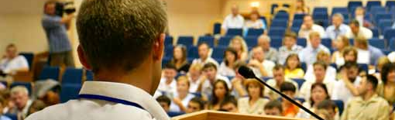
Giving an Effective Presentation – today
Audience Centered Speaking
Structuring and organising an academic presentation
Language for presentations

Slide 4
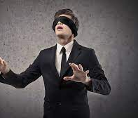
What is an Audience Centered Speaker?
Focused on the needs of the audience
Purpose Driven
Any communicative act requires a clear purpose – an aim or objective
Structure and organisation of content designed to meet that objective
Content structured to ensure the audience can follow
Choices of content & language

Slide 5

An Audience Centered Speaker…
Creates rapport with the audience
How?
By carefully considering content structure
By carefully choosing signal language
By carefully designing visuals to aid flow and highlight pivotal content
By engaging with the audience by speaking TO them not AT them
NVC – confident and open body language (Week 3)
EYE CONTACT
Notes:
Adapts to audience needs
If audience doesn’t seem to understand

Slide 6
Part 1 - The Presentation Structure
The introduction is arguably the most important part of the presentation. It contains key information for the audience.
It sets out a structure – and a presentation without clear structure will be confusing!
Outline the talk
When you’ll take questions
Announce length of talk
Introduce yourself
Signal the move to first section
Introduce the talk
Greeting
Identify the purpose of your talk

Slide 7
Structure & Organisation -the Introduction
Stage and Subtext
Greeting
Introduce yourself
Introduce your talk
Identify the purpose of your talk
Outline the talk
Announce the length of your talk
When questions will be taken
Signal move to first section
Ready to Start
WHO – credibility, reliability, authority
WHAT – general topic – connections & expectations
WHY – more specific connections & expectations
HOW – scope, depth, focus

Slide 8
Transcript with moves
Greeting: Good morning everyone, thank you for coming.
Introduce myself: My name’s Matt Potter. I’m a post graduate student in the SPIR.
Introduce talk: Today, I would like to focus on Brexit. Brexit is the withdrawal of the United Kingdom from the European Union following the public referendum in June 2016. The Brexit agreement came into legal effect from the 1st January 2022.
Introduce purpose: The purpose of my presentation today is to discuss the potential economic impact of Brexit both on the UK and the EU. A recent government report warned that Brexit would both reduce the EU's and the UK’s potential GDP and (thesis) I would like to offer a set of recommendations to help mitigate the worst elements of this impact.
Outline: In order to discuss this further, I have separated my presentation into three parts:
In the first section we will focus on the potential economic impacts on the UK’s economy over the next years.
Then we will move on to consider the parallel impact on the economy of the EU
In the final section, I would like to present a set of recommendations that could help alleviate the worst economic effects of the Brexit on the UK and EU economies respectively.
Length of talk: This presentation will be relatively brief, and I will only take 10 minutes of your time.
Questions: If you have any questions, please hold them until the end of the talk when I’ll be happy to answer them
Announce start: Ok, let’s get started with section one.

Slide 9
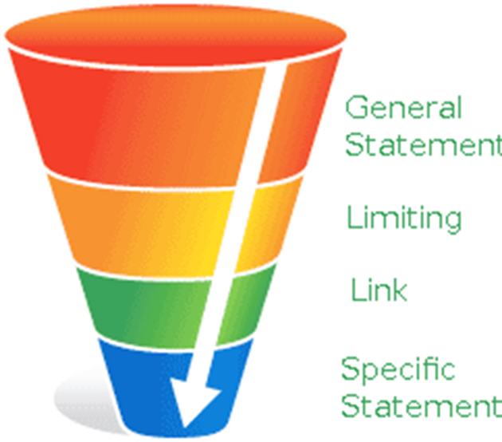
Funnel Introduction
Common in academic essay writing
Smooth flow of information from the general to the more specific

Slide 10

THE BODY – Movement Between Sections - Transition Language
Introducing your first point
Finishing a point
Starting a new point
Referring to what you have said
Referring to what you will say
Signaling the end
Summarizing
Concluding
Inviting questions

Slide 11
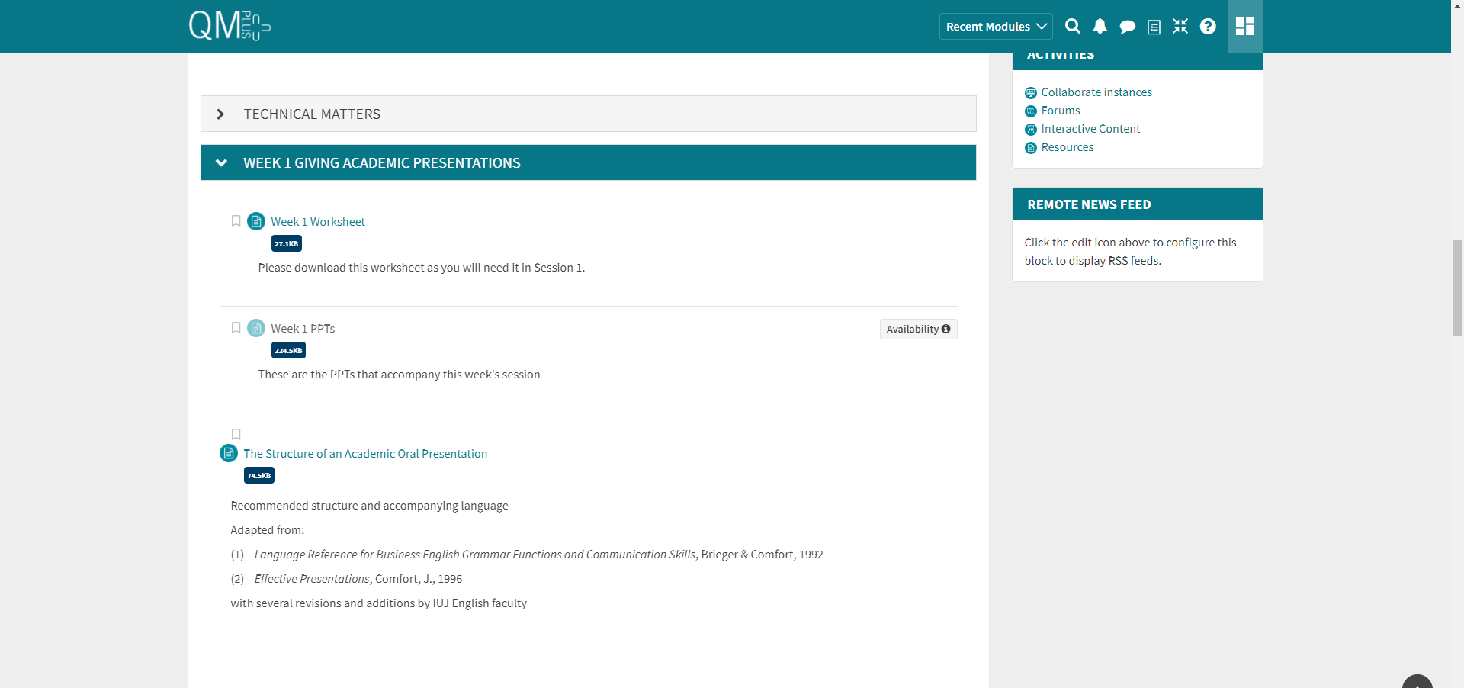
QM+
https://qmplus.qmul.ac.uk/course/view.php?id=1508

Slide 12
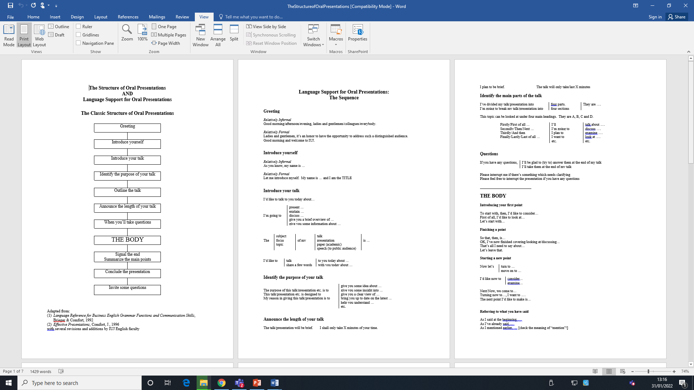
QM+
https://qmplus.qmul.ac.uk/course/view.php?id=1508

Slide 13

Task 3: Effective Presentations Practice
Just the introduction to a presentation on the topic of your choice
Use signal and transition language.

Slide 14
Homework
Record your short introduction and post the video to the Teams group here or email me directly for feedback
M.potter@qmul.ac.uk

